Slide 1
Smart Bin Project
Ivan Naumovski
Martino Secchi
Pervasive Computing Project 2016

Slide 2
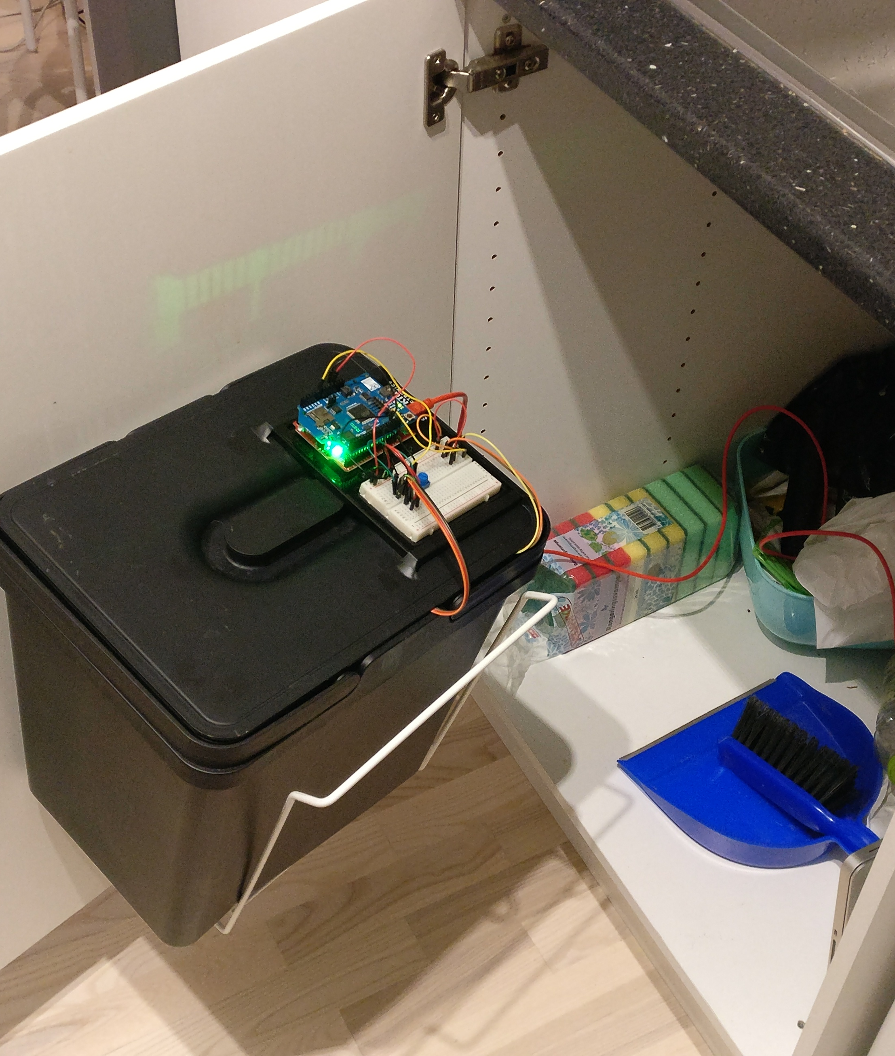
Smart Bin
An extension to a normal trash bin can measure and transmit your trash status.
Odor detection
Trash level
Centralised controller
Cloud based data service

Slide 3
Concept
The amount of trash is traditionally the leading parameter in
facing waste management related issues.
Most existing waste management systems compute this amount through weight data or distance from the top, while others use RFID based technologies to keep track of every item.
The concept behind our project is that the amount of trash is
not the only relevant parameter when talking about waste management.
Our system is able to detect smell levels emitting from the trash, to ultimately improve air quality especially in indoor environments.

Slide 4
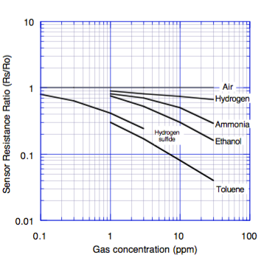
Odor detection
Food and protein decomposition
is the major source of bad smell in trash.
Machines can’t sense smell per se,
but by targeting specific gases product
of decomposition, they are able to predict
the likely smell level.
In particular, “smelly” gases by product of protein decomposition are: hydrogen sulphide, amines, methane, short chain alcohols (methanol, ethanol), …

Slide 5
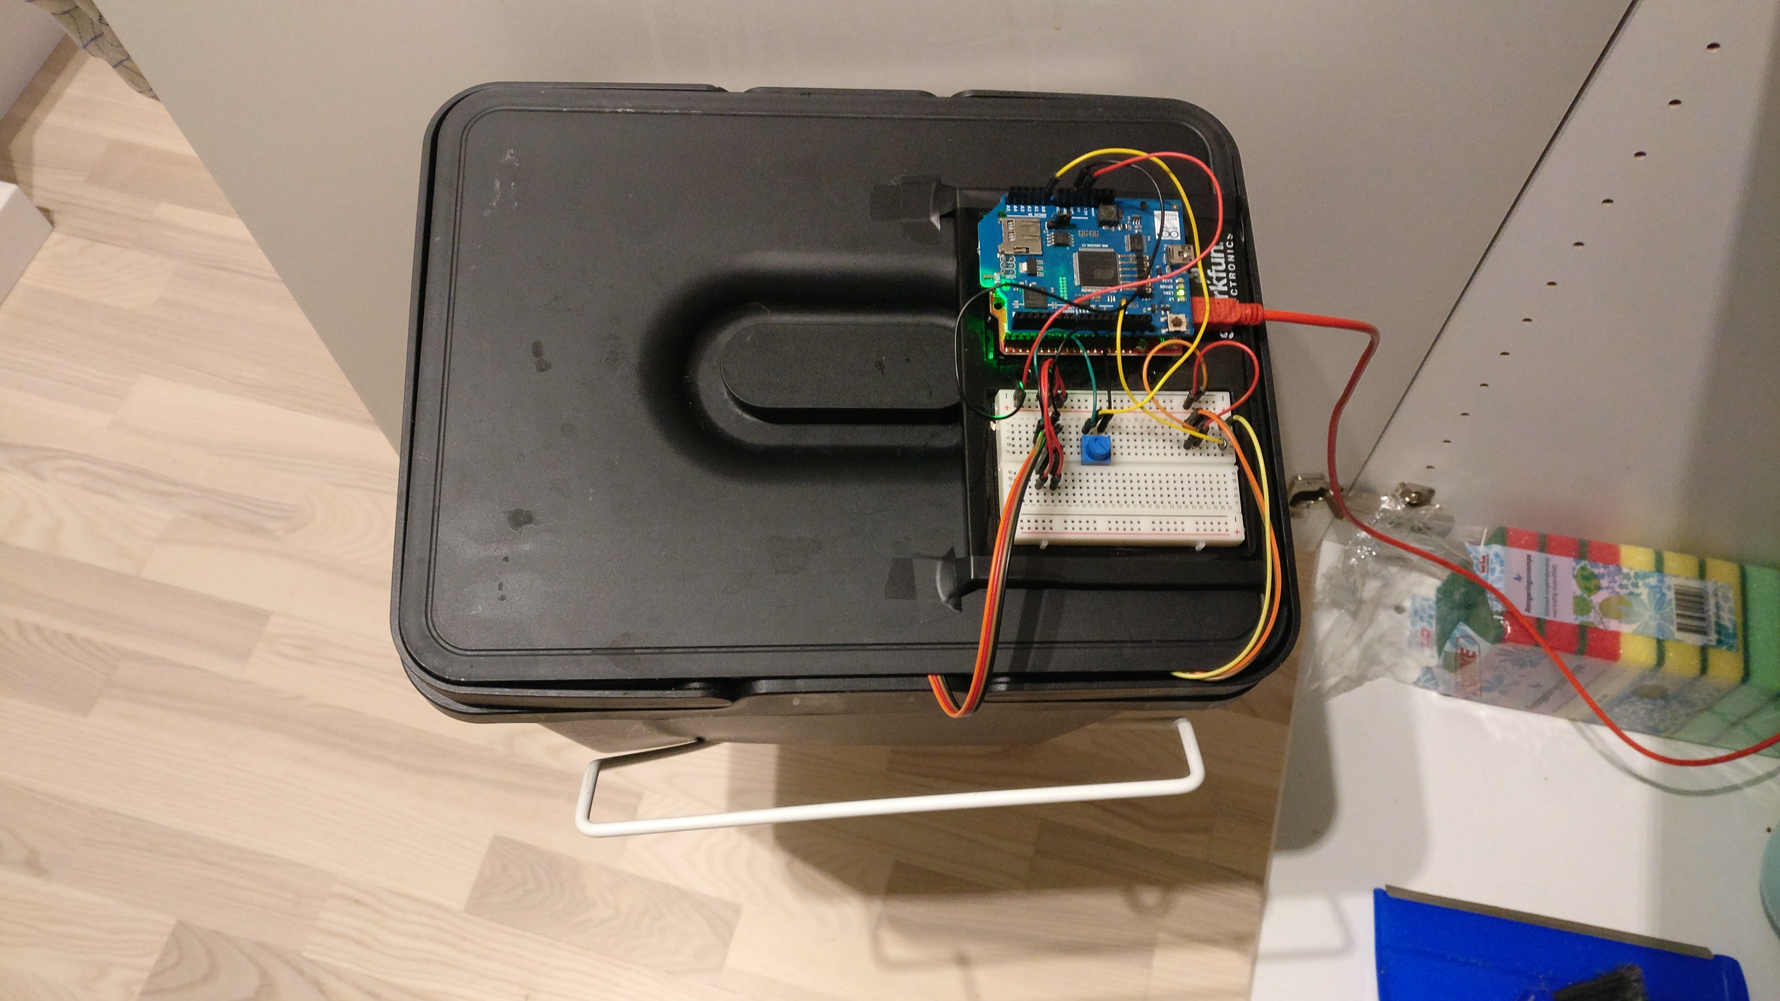
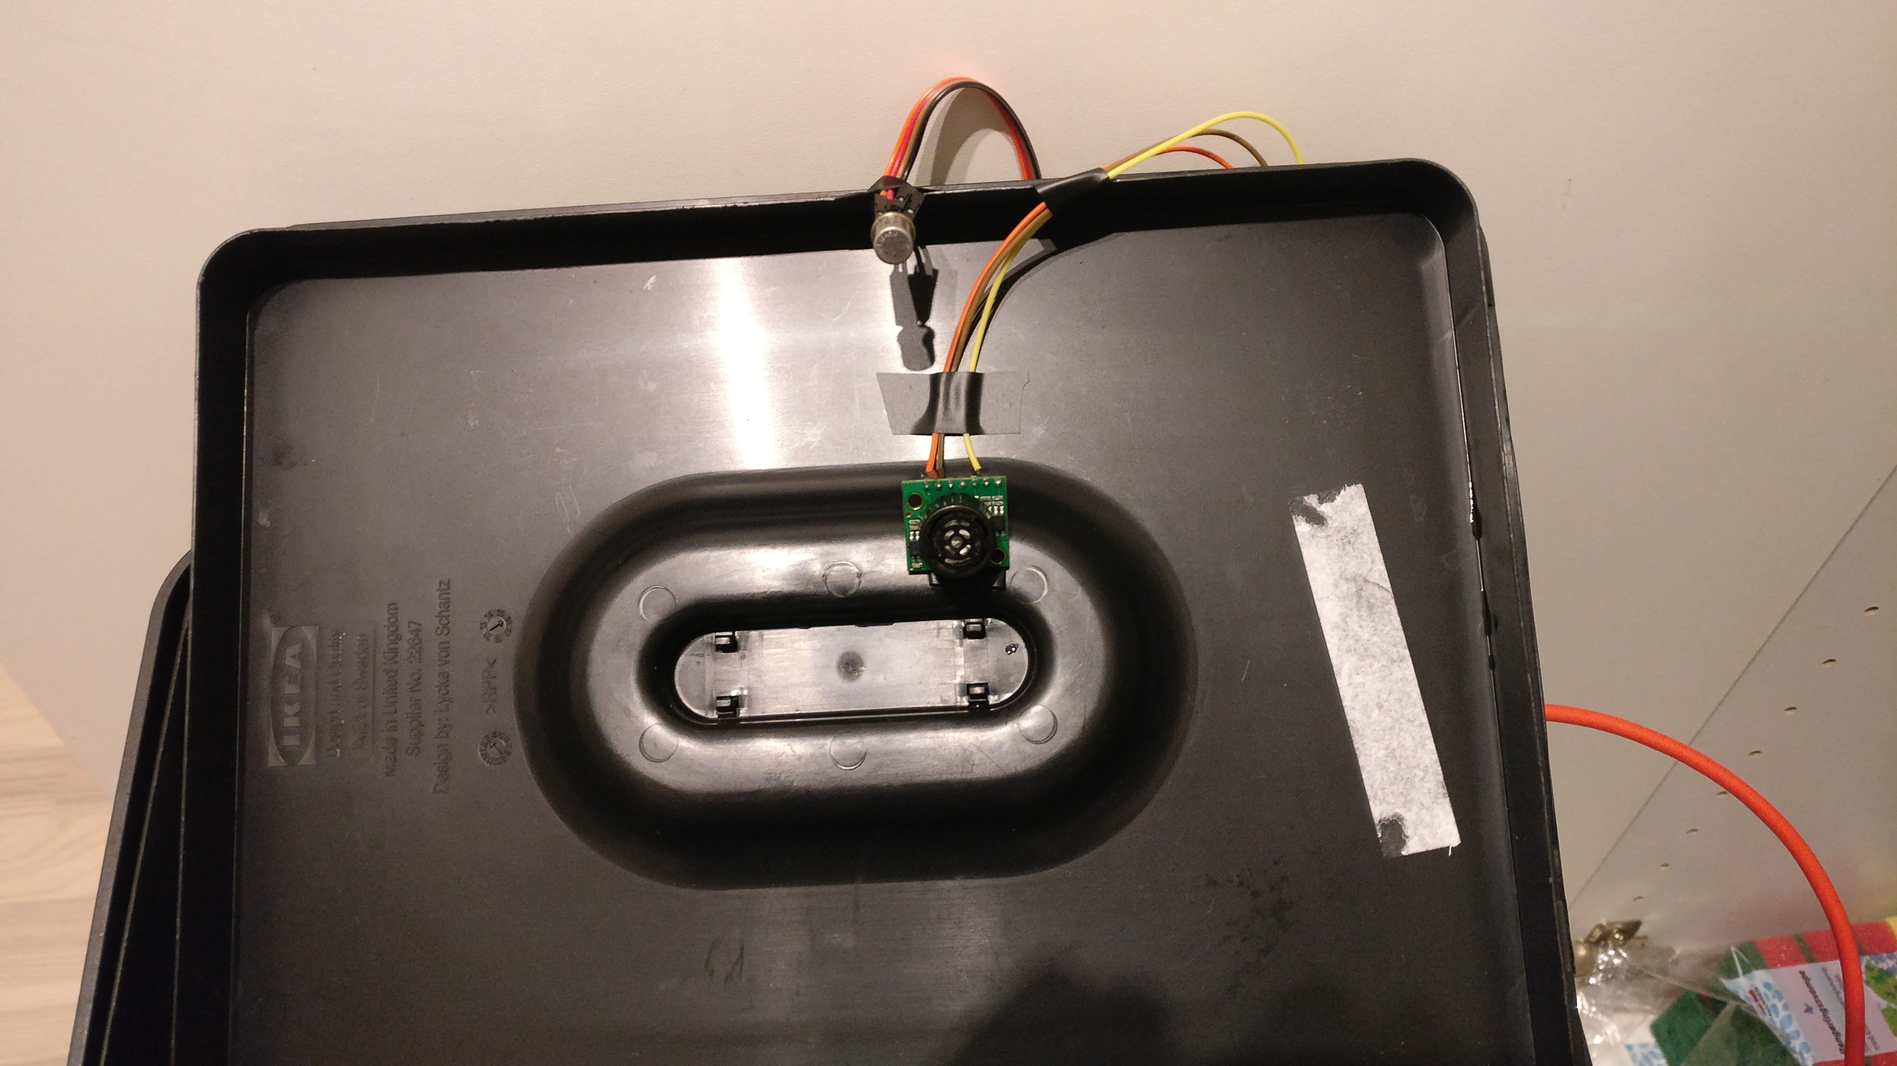
The device
For our project, we developed a prototype from a basic Arduino board and applied it on a bin.
The major components are: a smell sensor, an ultrasonic range finder, and a communication shield

Slide 6
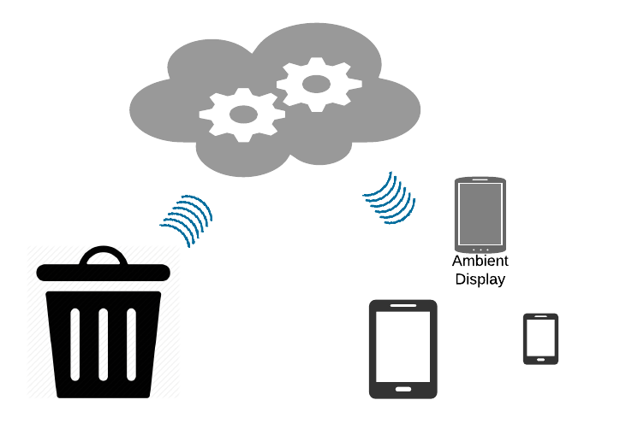
Cloud-based Architecture
Collected information is sent
directly from the bin to the
cloud, where it’s made
accessible to client devices
An ambient display placed inside
the house makes the information about
the trash status available at a glance.
Our client app Trash Companion can also
be installed on any Android device.

Slide 7
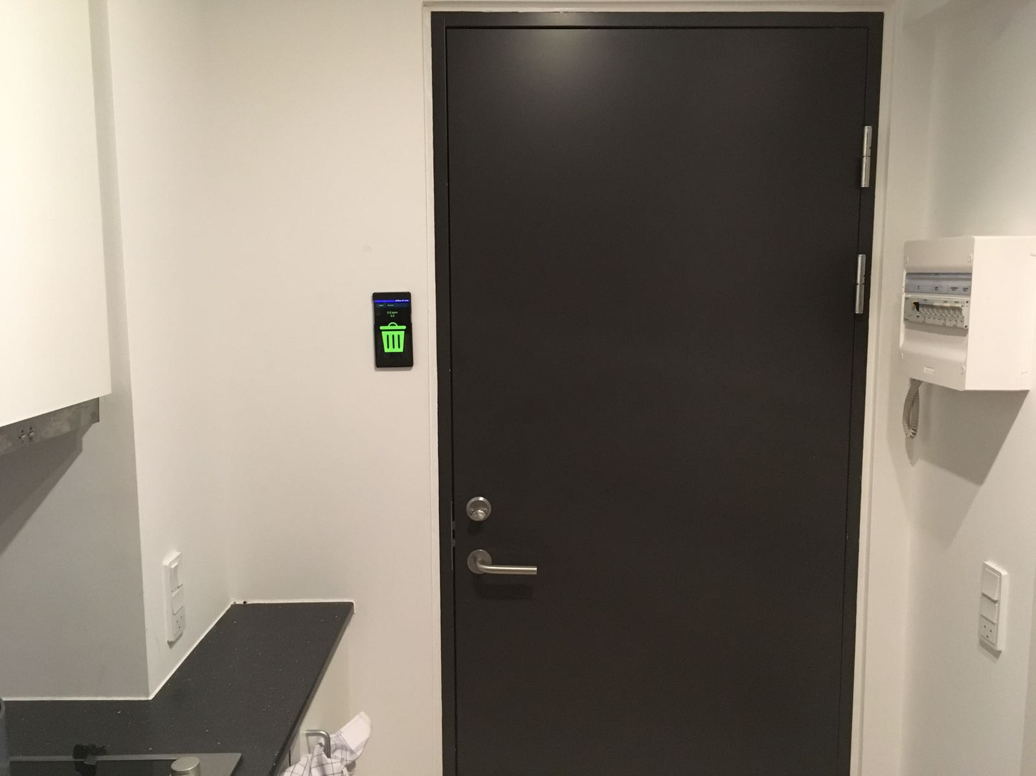
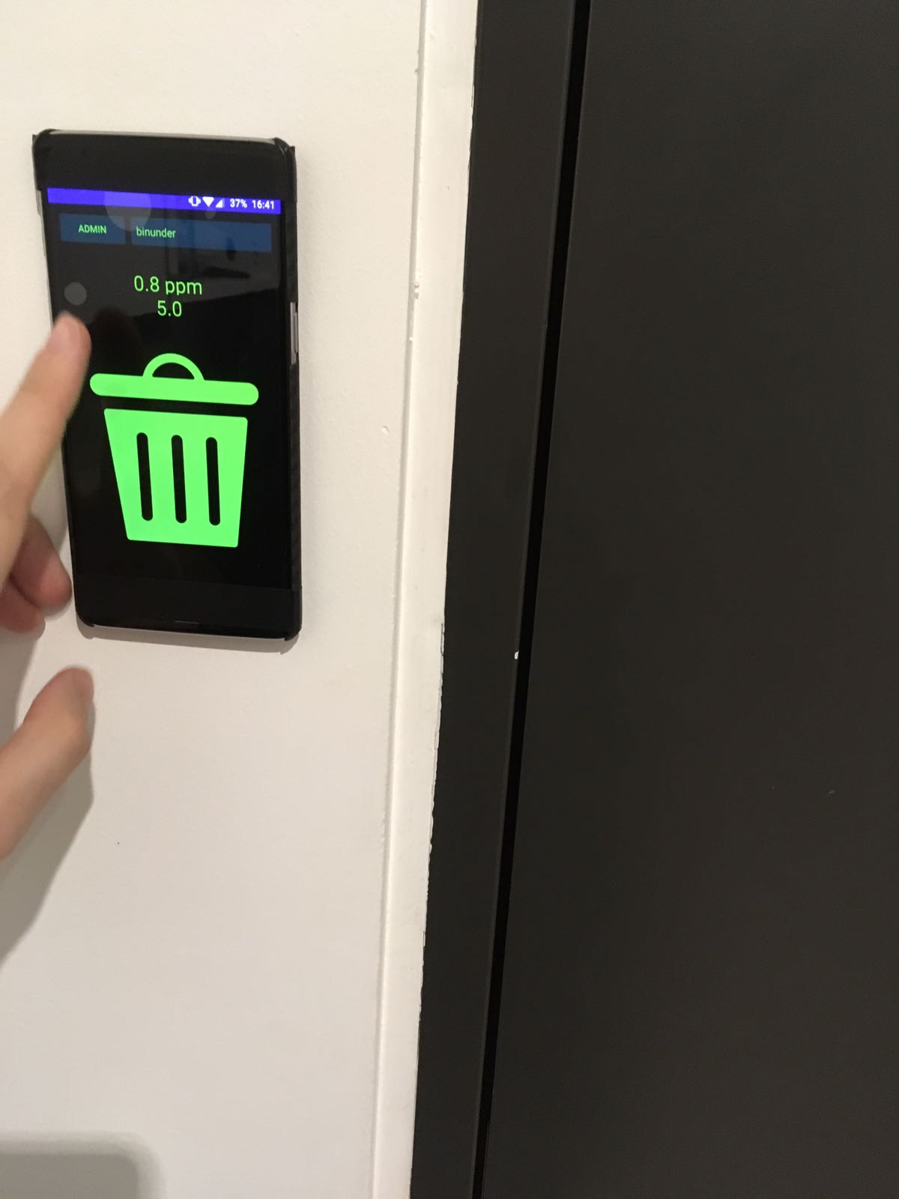
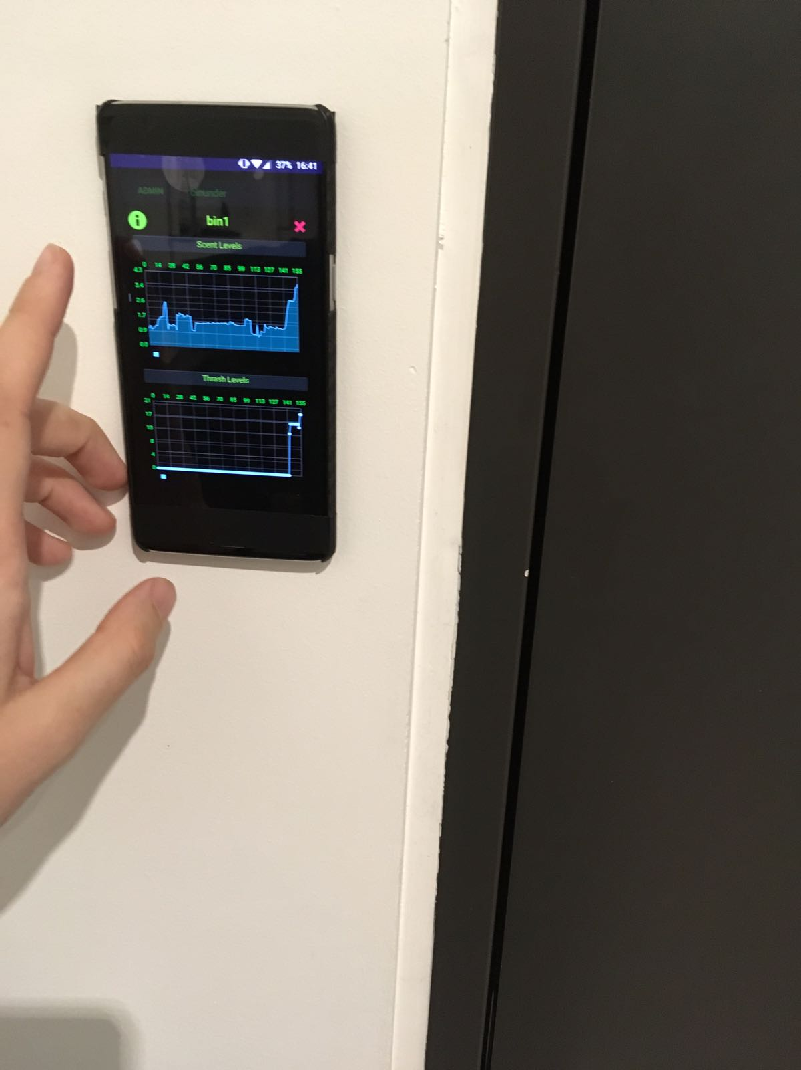
Ambient Display
The display is placed inside the house.The trash status is immediately visible from the color of the screen.
Further interaction is possible by pressing on the screen and selecting the desired information

Slide 8
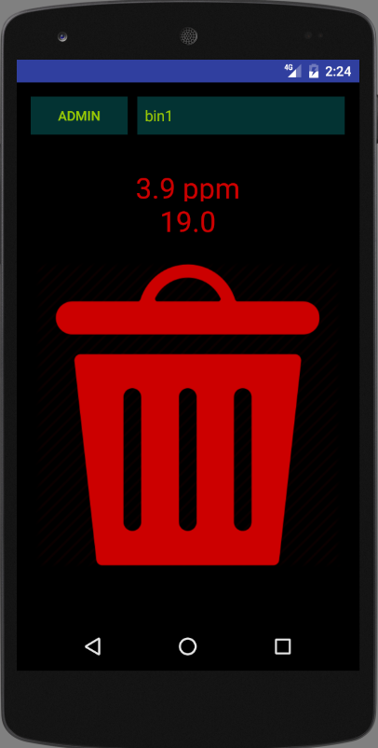
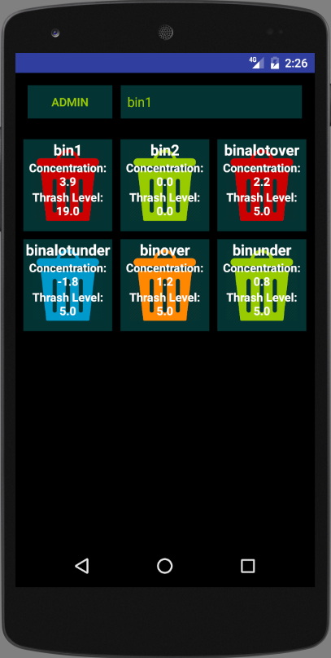
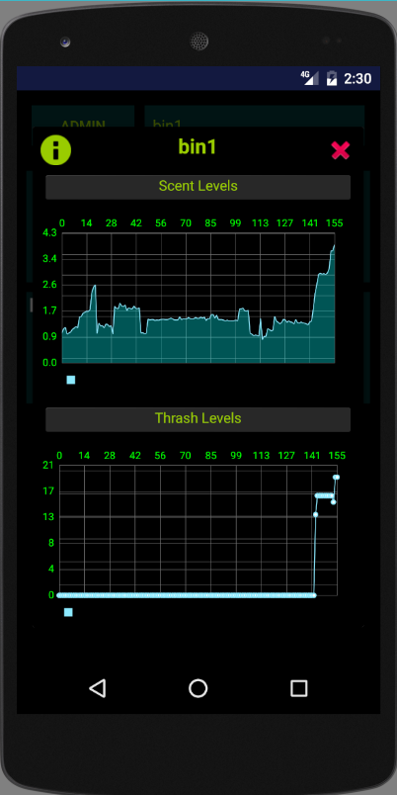
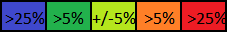
Android App
There are 5 stages of color depending on the level of smell emitting from the trash.
Also, smell level and trash height level are both on the screen.
It is possible to view the latest results for a set of different trash bins from the same owner, displayed as a graph of the latest data.

Slide 9
Conclusion
Smell can be accurately predicted by modern technology
Smell as a parameter is particularly relevant for indoor environments, but existing Waste Management Systems can be easily extended to contain it
Garbage collection could be driven by smell levels rather then/ in addition to trash amount

